Slide 1
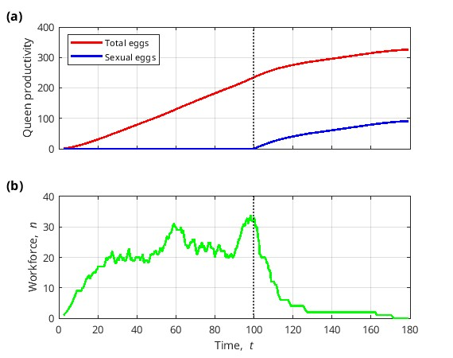
Figure S4. Example of the temporal dynamics of a colony life cycle with seasonality, which means that production of sexuals starts at some time point called tSexual. Here, tSexual = 100.

Slide 2
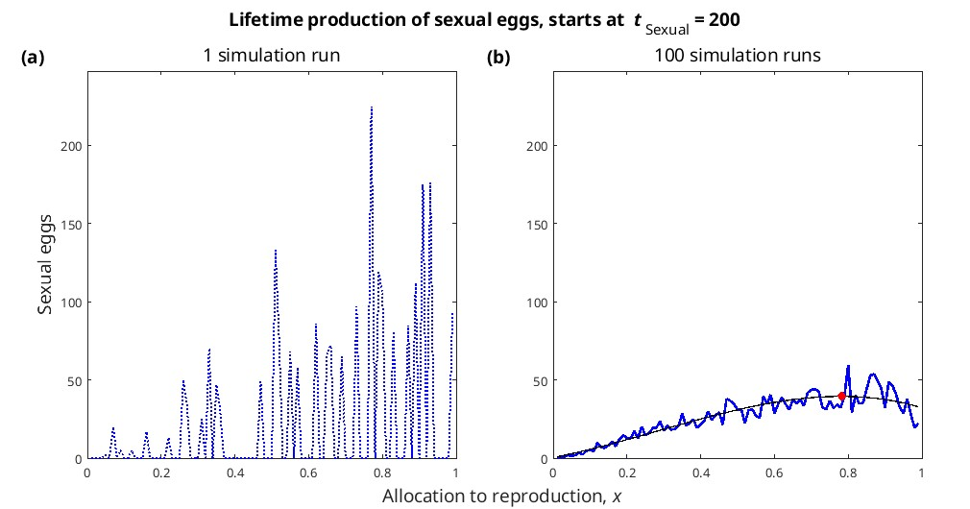
Figure S5. Lifetime production of sexual eggs as a function of the proportion of resources allocated into reproduction, x, with seasonality (tSexual = 200). (a) 1 simulation run; (b) The blue line shows the mean of 100 simulation runs, the black line shows a polynomial fit (degree = 3), and the red dot shows the maximum of the fit. Number of sexual eggs not log-transformed.

Slide 3
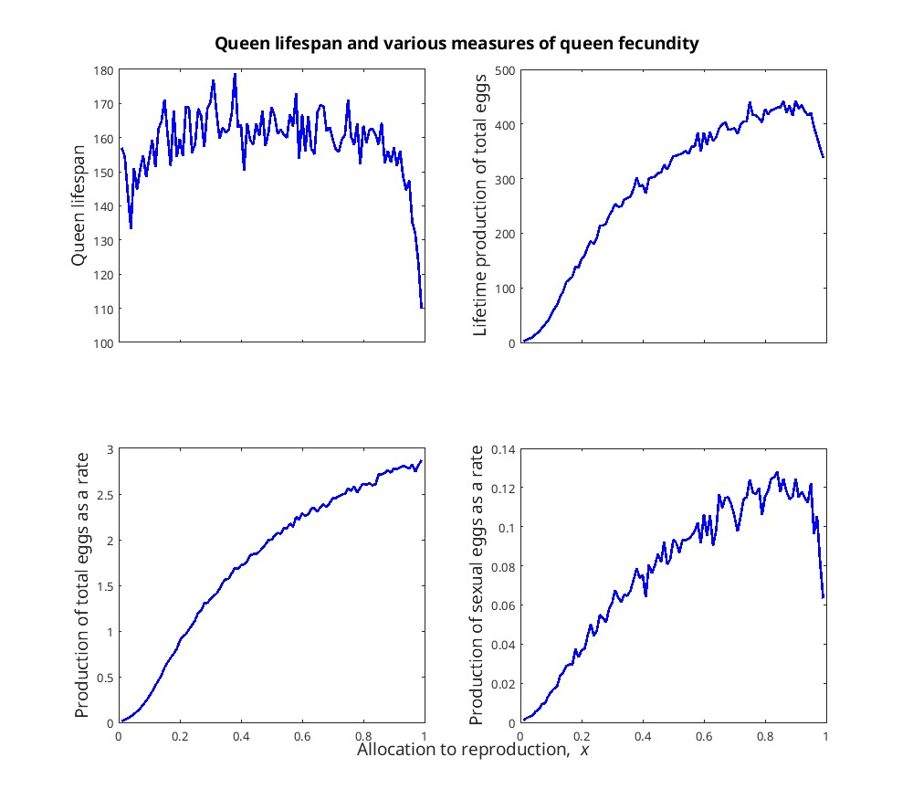
Figure S6. Queen lifespan (a), lifetime production of total eggs (b), production of total eggs as a rate (c), and production of sexual eggs as a rate (d) as a function of the proportion of resources allocated into reproduction, x, with seasonality (tSexual = 200). Number of sexual eggs not log-transformed.

Slide 4
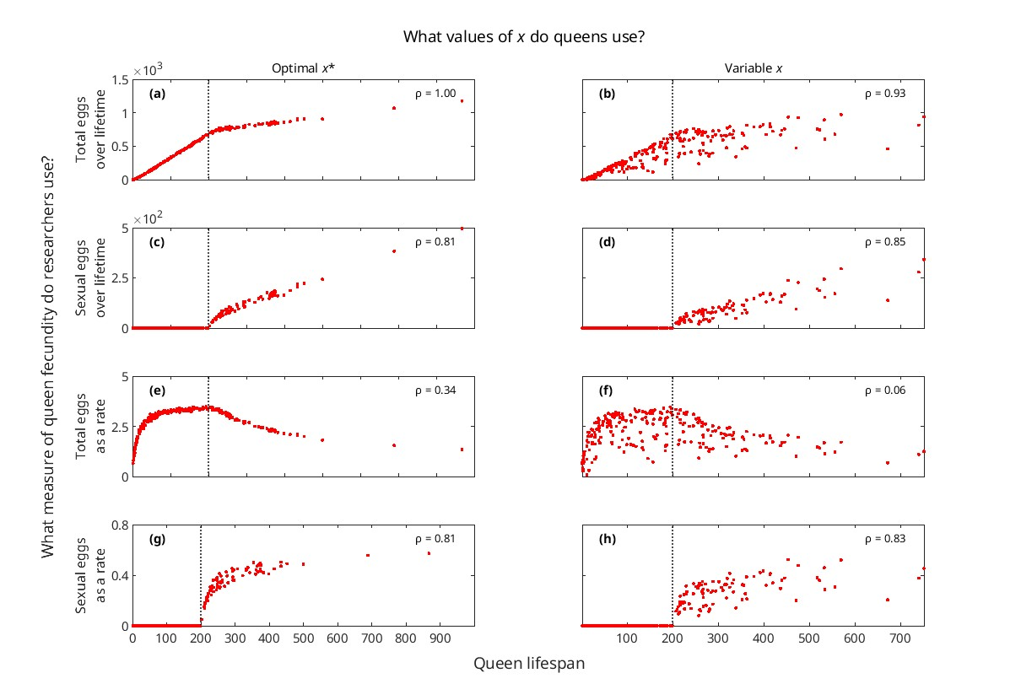
Figure S7. Correlation between queen lifespan and fecundity, shown for different measures of queen fecundity (rows) and different x values used by queens (columns), with seasonality (tSexual = 200).

Slide 5
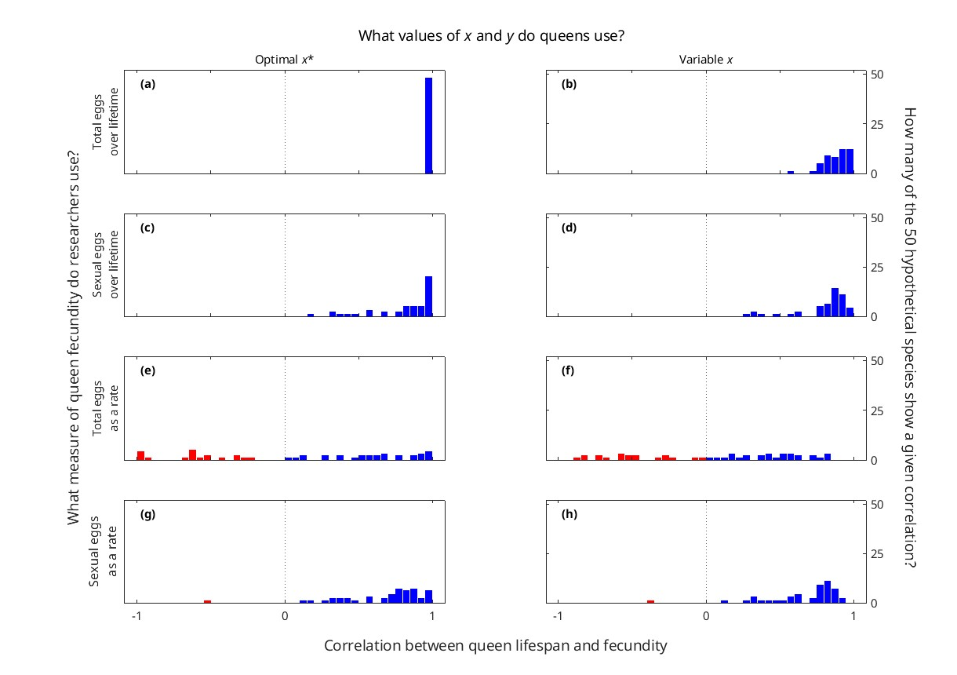
Figure S8. Distribution of correlation between queen lifespan and fecundity, shown for different measures of queen fecundity (rows) and different x values used by queens (columns), for 50 randomly chosen combinations of values for parameters μW, μQ0, a1, a2, and a3, with seasonality (tSexual = 200).

